Slide 1


CyberSIEM
Team Nirvana Members
Mission Statement:
To provide and enable strategic threat detection and response in the wake of sophisticated security needs
Founded in
2018
Headquarter
San Francisco
Employees
175
Company Domain
Cyber Security
Target Market
Security Information and Event Management

Slide 2
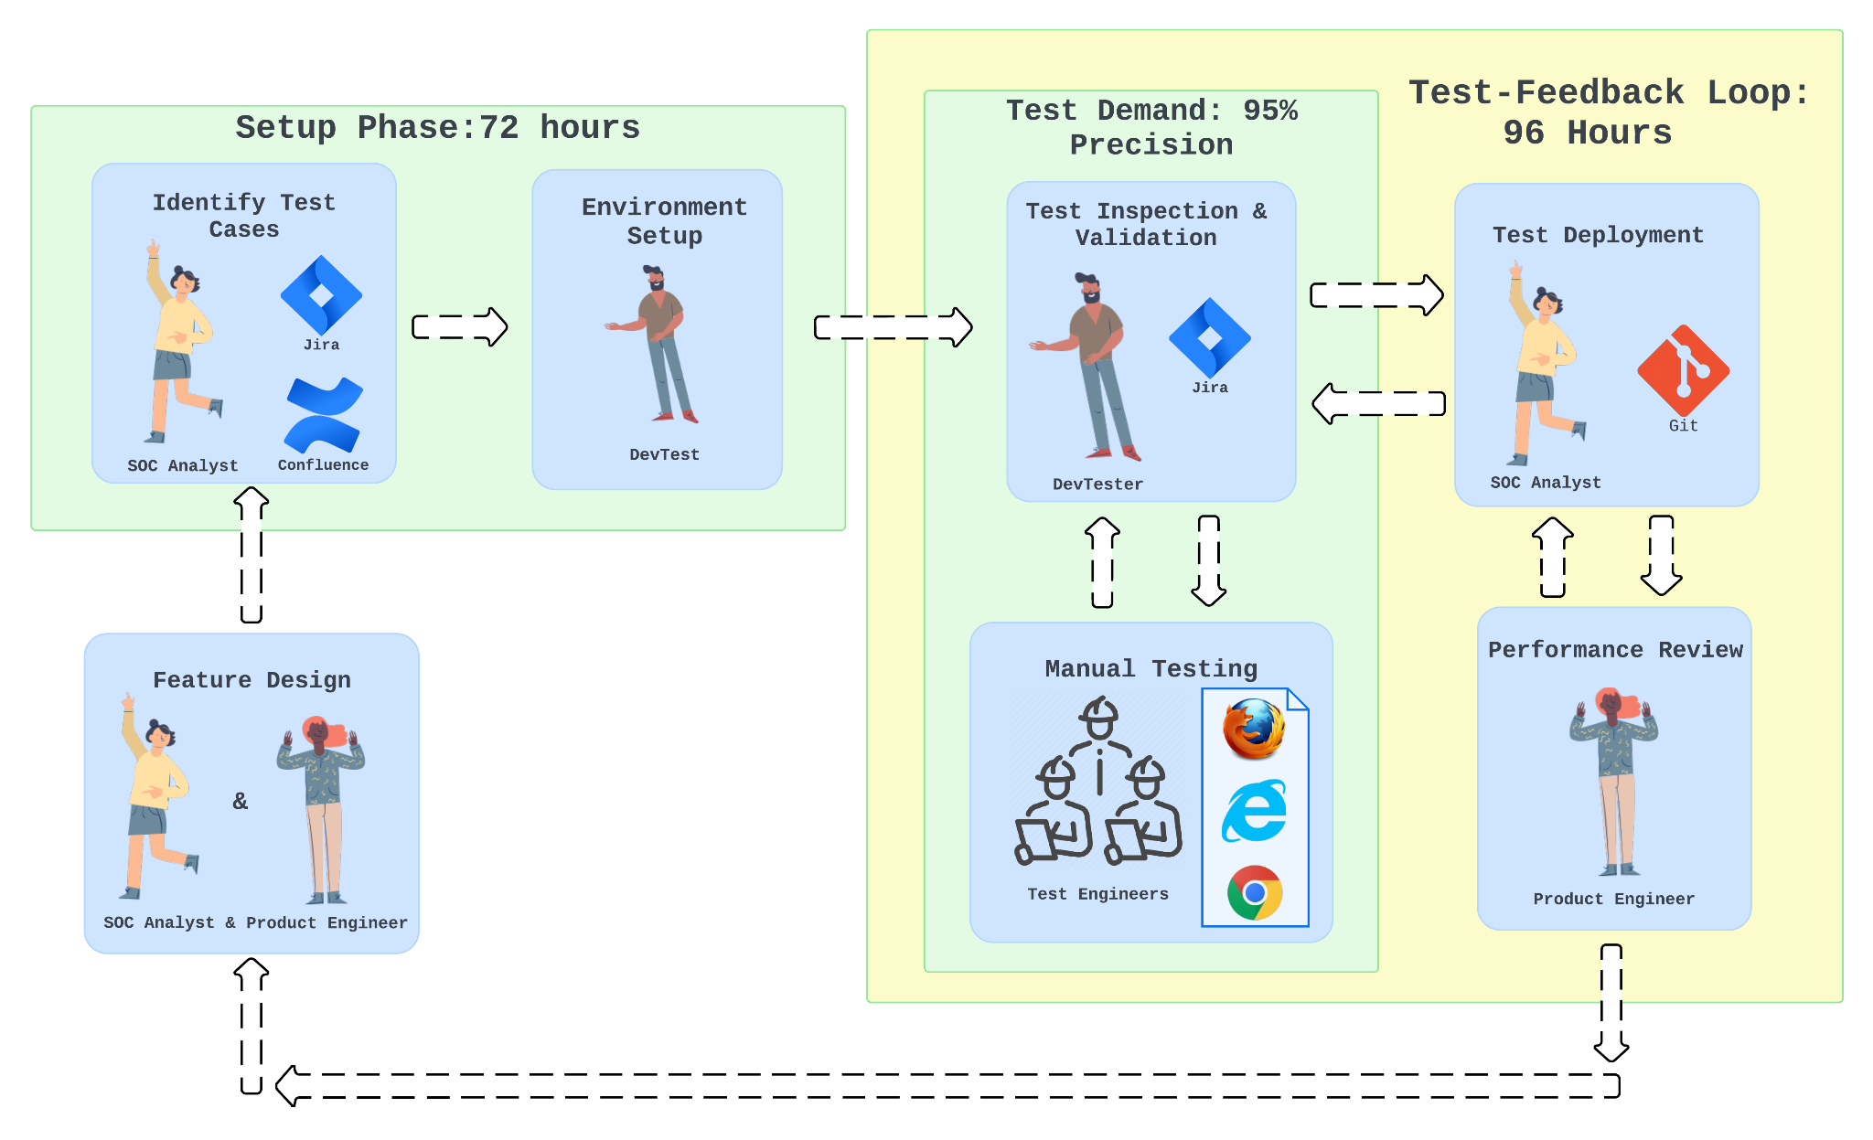
Challenges
Business Objectives
Internal SOC* Team(Customer 0) has to perform:
Manual RBAC** enabled End-to-End testing
Mainline and Hotfixes
Testing Process:
Currently –> 300 manual test cases
Total Regression Test & Feedback turnaround
Test setup + Manual execution +Manual analysis (of test results) = 168 hrs
Reduce end-to-end regression testing efforts and costs
Reducing the time taken to give feedback to the development team by 50%, in turn enabling the development team’s throughput
Identifying and reporting bug/s impacting the strategic threat detection and incident response workflows
*Security Operations Center
**Role Based Access Control

Slide 3

‘Magic Quadrant’ Analysis
Cross-X Support
Mature and widely accepted and used across industries with cross and multi language and browser support [2]. Framework allows more control over browser interactions and integrations
Selenium
Simplified API offers less fine-grained control over browser interactions compared to Selenium, leverages selenium libraries and has browsers support other than chromium instances
Selenide
Niche
Scalability
Niche Player in the market and is inflexible for customization options for test data management [1], reporting, and framework integration.
Cypress
Selenium as a Test Automation Framework and Java as the programming language would marry and be a perfect fit given the nature of the nature of the project
Inflexible
[1]Jash Unadkat, Comparison of Cypress, 2023,https://browserstack.com/guide/cypress-vs-selenium
[2] Himanshu Sheth, Selenium Tutorial and its Advantages, April, 2024, https:/.lambdatest.com/blog/why-selenium
Notes:
1 minutes

Slide 4
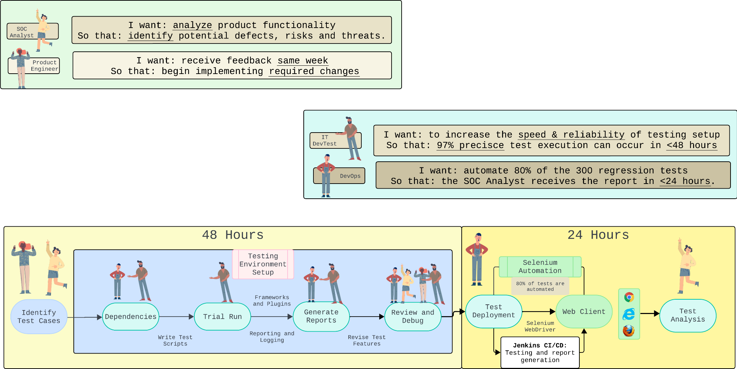
Why?
How?
To-Be

Slide 5
Release Plan
Timeline | Jan | Feb | March | April | May | June
Increment/Release Version | V0.2.0 Increment 1 (Precision theme, development unit tests) | V0.3.0 Increment 1 (Efficiency theme, integration test) | V0.5.0 Increment 2 (Precision/Efficiency themes; alpha test, regression test) | V0.7.0 Increment 2 (Precision Theme; Beta Test) | V0.8.0 Increment 3 (Efficiency Theme; System/ Performance Test) | V1.0.0 Increment 3 (Security Theme; Golden Build Test)
Release Versions | V0.0.0.P.D.ND.7 V0.1.0.P.D.ND.5 | V.0.2.0.E.I.ND.3 V0.2.0.E.I.ND.6 | V0.3.0.E.A.ND.4 V0.4.0.P.R.ND.3 | V0.5.0.P.S.ND.5 V0.6.0.P.B.ND.3 | V0.7.0.E.S.ND.5 V0.7.0.E.P.ND.8 | V0.8.0.S.G.ND.3 V0.9.0.S.G.ND.5
Release Highlights | 40% Automated unit tests Reduction in false positive testing, Precision testing against historical tests Integration of Selenium with Jenkins CI/CD | Selenium Grid feature added 33% reduced setup time to 48 hours | Over 95% regression test pass rate 50% reduction in execution time to 48 hours with Selenium Grid 0 high severity bugs in test setup/execution | 70% Automated unit tests JUnit reporting feature added 50% reduction in false positives rate with 97% precision, Beta testing | 75% reduction in test execution time to 24 hours compared to initial execution time, total turnaround time (setup & execution) is 72 hours | 80% Automated unit tests 0 control related security incidents, limit security incident response time to 1 hour
Key Contents | Test Script Set, False Positive Patch, Test result reports, Execution time summary | Selenium Grid configuration file, Setup time report | Jenkins Configuration, Regression test reports, Execution time summary | Selenium WebDriver configuration file, Beta test feedback and validation reports | Performance test reports, System test reports, Execution time summary | Security test reports

Slide 6
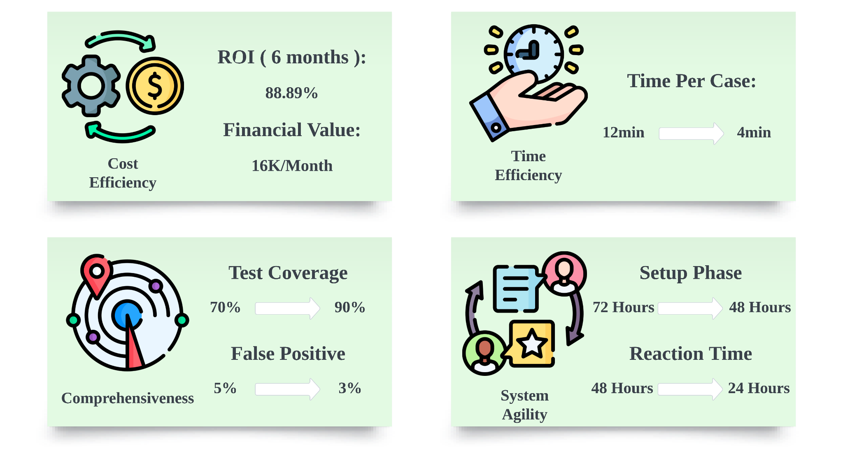
ROI & ROV
Notes:
Zhen 1 minute

Slide 7
Thank You

Slide 8
Appendix

Slide 9
Personas^{[1]}
DevOps
IT DevTester
Product Engineer
SOC Analyst
Security Manager
[1] Slidesgo. "People Pattern." Accessed April 19, 2024. https://slidesgo.com/theme/people-pattern.
Notes:
90 seconds

Slide 10
Customer 0 Explained
CIO
Internal SOC
C0
CyberSIEM
Product
External Customer
SOC Analyst
Product Dev
Engineer

Slide 11
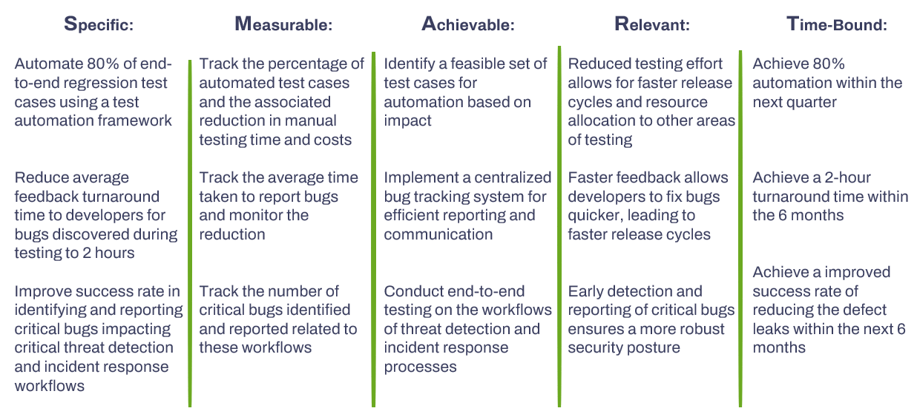
BO.1
BO.2
BO.3
Notes:
2 minutes

Slide 12
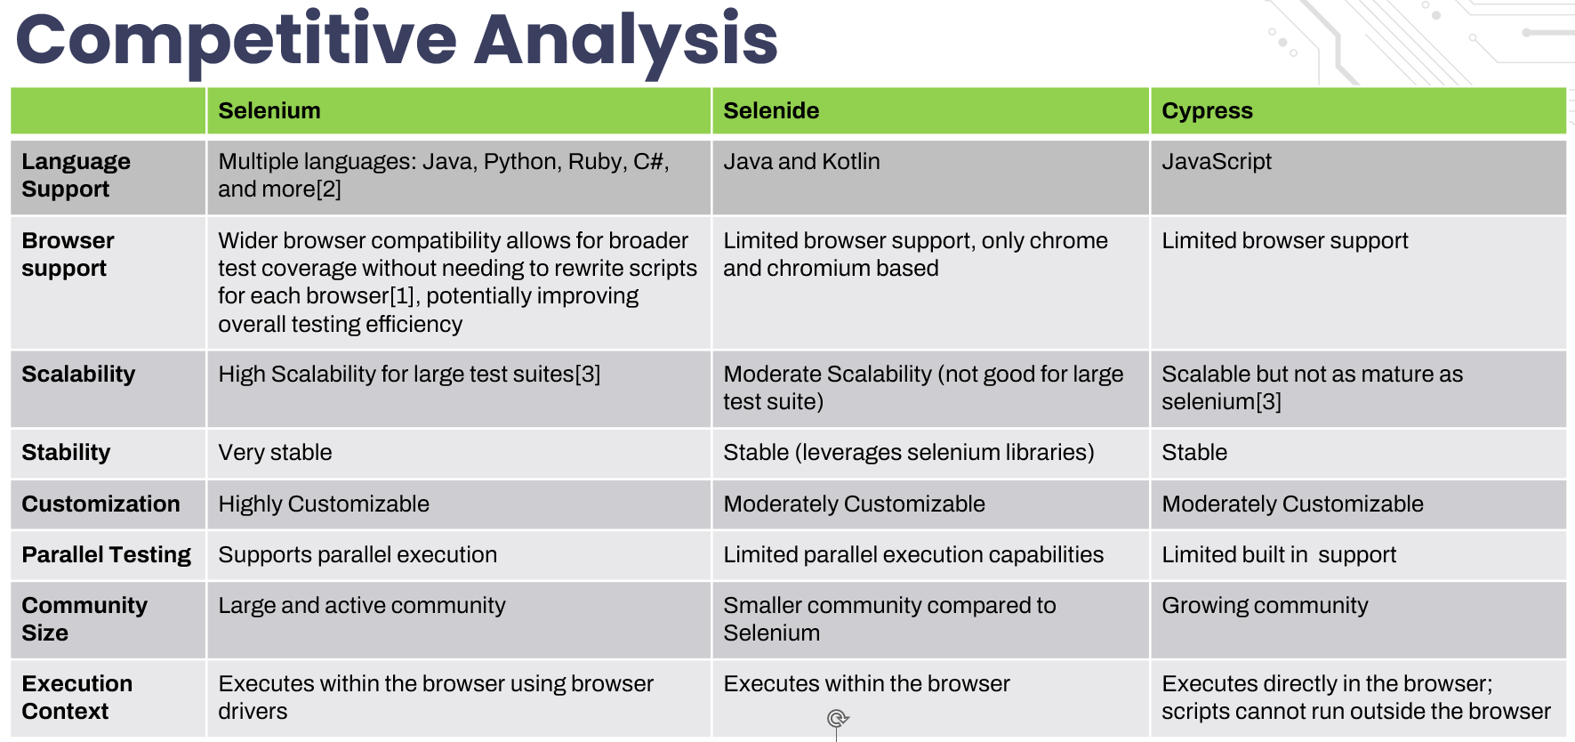
[1]Selenium Documentation, Supported Browsers v4.0(2022), https://selenium.dev/documentation/webdriver/browsers/
[2]Selenium Documentation, Installing Libraries v4.0(2023), https://selenium.dev/documentation/webdriver/getting_started/install_library/
[3] Himanshu Sheth, Selenium Tutorial and its Advantages, April, 2024, https:/.lambdatest.com/blog/why-selenium
[4]Selenium Documentation ,Bi Directional Functionality v4.0(2023),https://selenium.dev/documentation/webdriver/bidirectional/
Simple

Slide 13
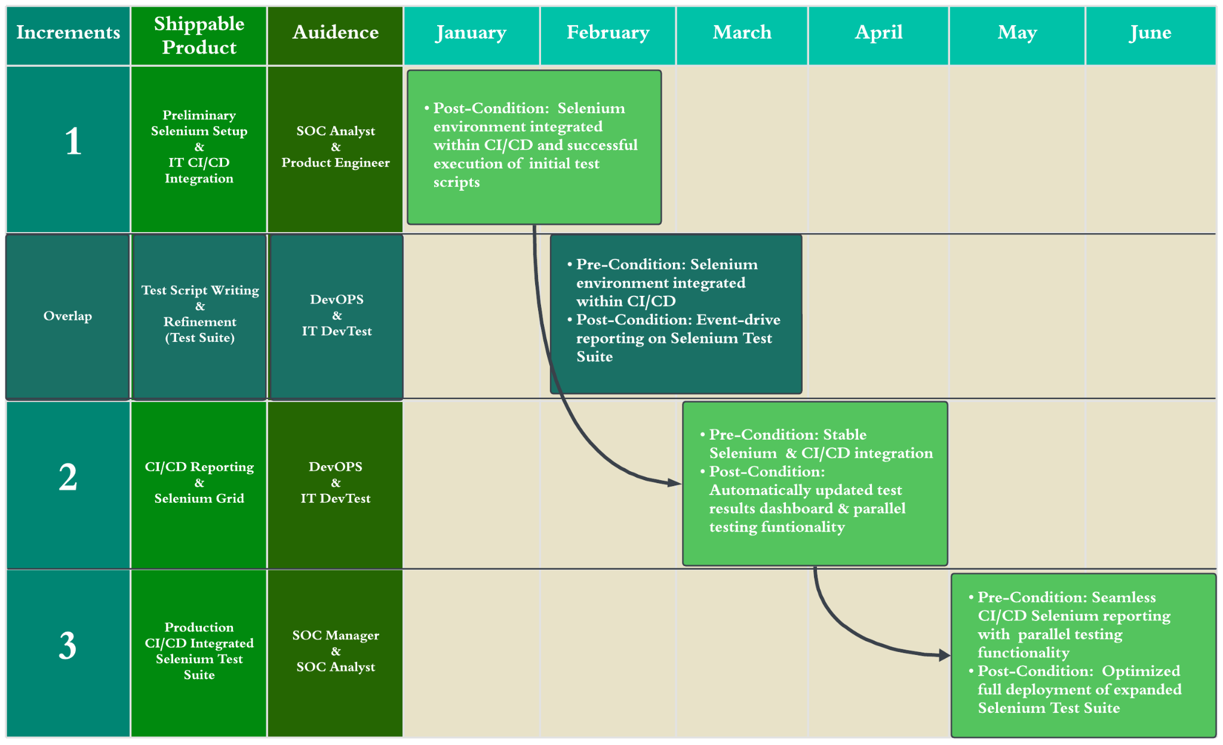
Notes:
Louis: 2 minute

Slide 14
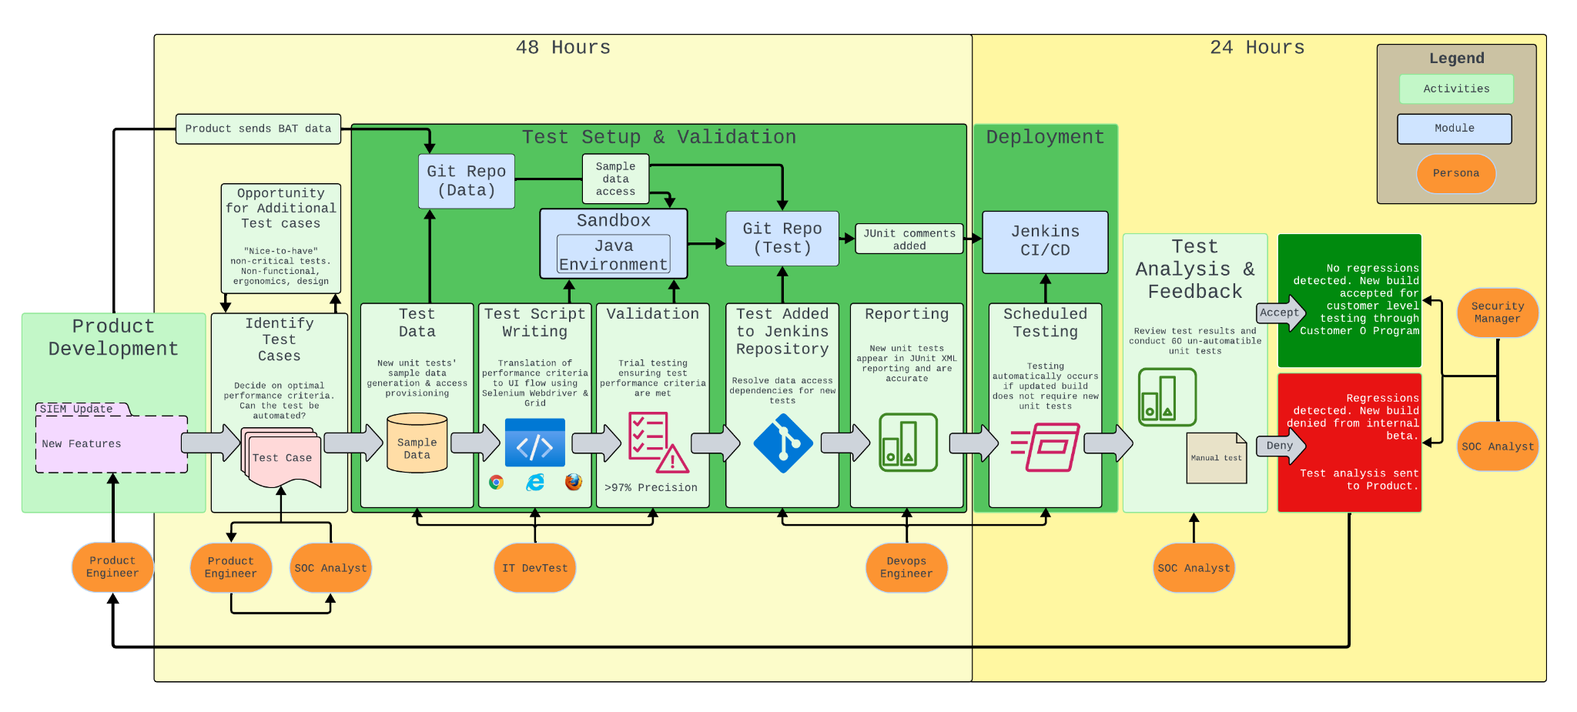
Architecture
[1] [2] [3]
[1]Logo: Google Chrome, Browser, https://www.google.com/chrome/
[2] Logo: Microsoft Edge, https://microsoft.com/en-us/edge
[3]Logo:Mozilla Firefox, Browser, https://mozilla.org/en-US/firefox/new/
Average

Slide 15
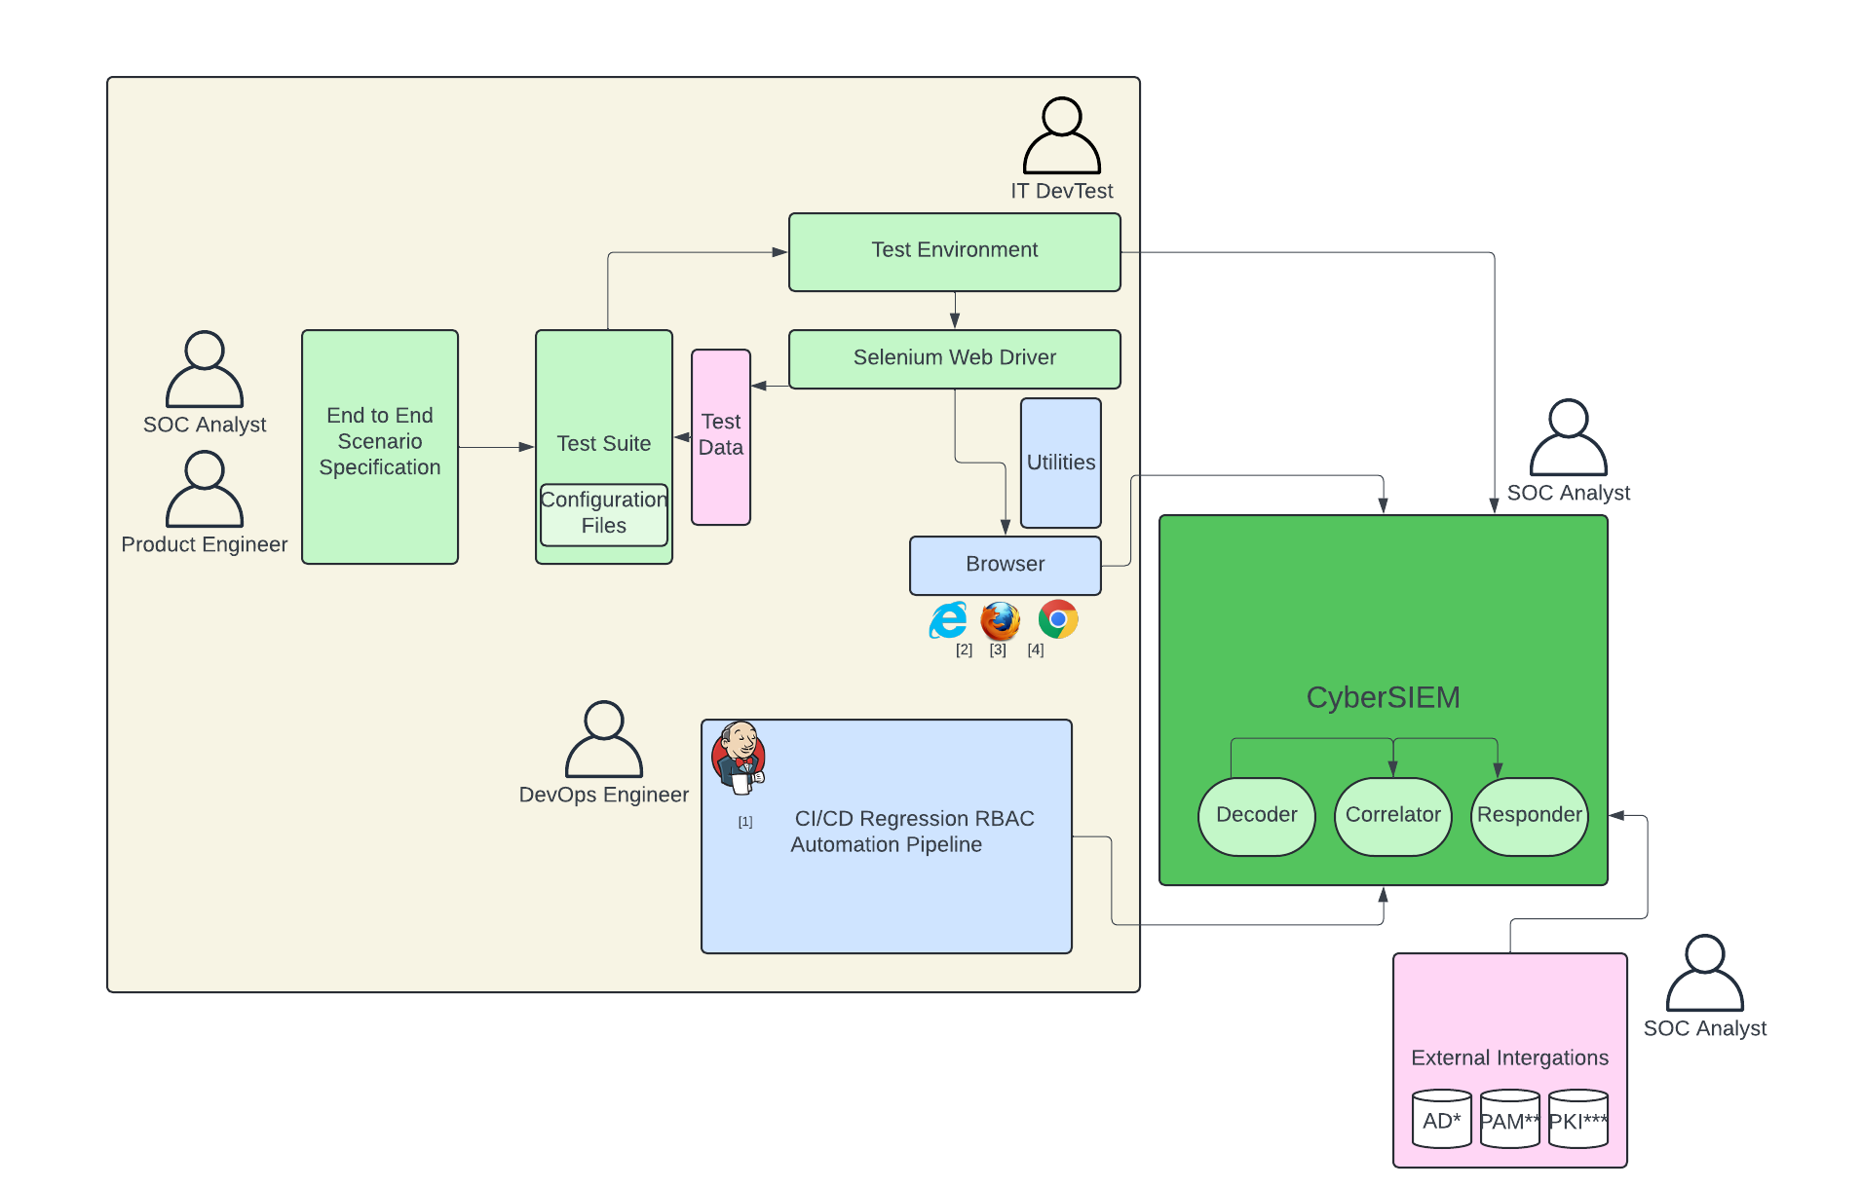
High Level Design
[1] Logo: Jenkins, Jenkins Pipeline https://jenkins.io/
[2] Logo: Microsoft Edge, https://microsoft.com/en-us/edge
[3]Logo:Mozilla Firefox, Browser, https://mozilla.org/en-US/firefox/new/
[4]Logo: Google Chrome, Browser, https://www.google.com/chrome/
*Active Directory
**Privileged Access Management
***Public Key Infrastructure
Simple

Slide 16
ROI (Dollar)
Employment Costs and Savings:
Reduction from 15 testers to 6 testers and addition of 2 automation engineers.
Pre-automation 6-month cost for 15 testers: $750K.
Post-automation 6-month cost for 6 testers and 2 automation engineers: $550K.
Total employment cost savings for 6 months: $900K (pre-automation) - $660K (post-automation) = $240K.
Automation Development Cost:
One-time cost for creating and integrating automated scripts: $120K.
Training and IT indirect support services in 6 months: $60K
Costs associated with restructuring of new employees: $20K
Assumptions:
Salary of a Tester according to industry standards: $100K annually.
Salary of an Automation Engineer according to industry standards: $150K annually.
Improved test coverage and accuracy result in a reduction in post-production bugs and related costs.
Enhanced product quality leads to increased customer satisfaction and an estimated increase in sales.
Project duration: 6 months.
Burden rate: 20%.
Backup

Slide 17
ROI (Dollar)
 | Manual | Hardware | AWS^{[1]}
CPU / RAM | 4 Cores CPU 4-8GB RAM | 8 Cores CPU 16GB+ RAM | EC2 Instance (c5.2xlarge)
Storage | 256-512GB SSD | 512GB-1TB SSD | EBS Storage (750GB each)
Data Transfer | / | / | 100GB
Bandwidth | 300-500Gbps | 1Gbps | 10Gbps
ROI Calculation:
Total gain from investment: $240K (employment cost savings) + $100K (additional financial benefits) = $340K.
Total cost of investment: $120K (automation development cost) + ¥60K(shadow resource cost)= $180K.
Net gain from investment: $340K (total gain) - $1800K (total cost) = $160K.
ROI = ($160K / $180K) * 100 = 88.89%.
[1] Amazon Web Services, Inc. "Amazon EC2 Pricing." Accessed April 19, 2024. https://aws.amazon.com/ec2/pricing/.
Backup

Slide 18
ROV
Time Efficiency | Reduce time expense per case by 64.17%, from 11.22 minutes to 4 minutes.
Test Coverage and Frequency | Improve test coverage from 70% to 90%. Reduced false positive rate of test cases from 5% to 3%.
Resource Optimization and Cost Efficiency | Save team’s time on testing by 57.14%. Generate $16K of financial value per month from productivity improvement.
Consistency and Reproducibility | Shorten the test setup and validation process from 72 hours to 48 hours.
Rapid Feedback and Continuous Improvement | Reduce the reaction time from Internal SOC (Customer 0) to Product from 48 hours to 24 hours.
Backup
Notes:
Time Cost per Case Calculation:
Pre-automation:
Total test duration: 7 days
Number of test cases: 300
Work hours per day: Assuming 8 hours/day
Total work hours: 7 days×8 hours/day=56 hours
Time cost per test case:56 hours / 300 cases ≈ 0.187 hours/case
Post-automation:
Total test duration: 3 days
Number of test cases: 360
Work hours per day: Assuming 8 hours/day
Total work hours: 3 days × 8 hours/day = 24 hours
Time cost per test case:24 hours / 360 cases ≈ 0.067 hours/case
Resource Benefit Calculation:
Pre-automation monthly test hours: 2000×0.187=374 hours/month
Post-automation monthly test hours: 2000×0.067=134 hours/month
Assumed Hourly Rates:
Tester's hourly rate: $50
Automation engineer's hourly rate: $75
Cost Calculation:
Pre-automation cost: Cost = 374 hours/month × 15 testers ×$50/hour=$24,933.33/month
Post-automation cost: Cost =134 hours/month × (6 × $ 50 + 2 × $ 75 ) = $8,950/month
Monthly Financial Benefit: Financial Benefit =$24,933.33 − $8,950 = $15,983.33/month
Financial Benefit over 6 months: Financial Benefit (6 months)=$15,983.33×6=$95,900

Slide 19
Risk Analysis
Risk | Risk Description | Mitigation Strategy | Impact | Likelihood
Cross-Browser Compatibility Issues | UI flow between browsers may be different. If browser updates affect the UI, test scripts may not work. | Use a Browser Compatibility Matrix to determine where code can be reused, and what must be custom. Update all browsers to determine if UI changes affect test scripts. If they do, DevTest must be alerted so changes can be made. to ensure that the newest security measures are updated and eliminate bugs [1] | High | Medium
No Built-In Reporting Capabilities | 3rd party (JUnit) reporting comments must be updated when test scripts change. If JUnit comments are not updated, reports will not represent new test cases. | Formally Audit JUnit reports quarterly to ensure that reports are representative of the test suite. Review JUnit updates before implementing them to ensure no compatibility issues occur. | High | Medium
Performance Bottlenecks & Scalability Issues | Many test instances require product and data access, adding to system strain. Potential to overload local resources, resulting in system crash. | Parallel Testing sequence changes are immediately implemented if a new test has a dependency. Use Explicit Wait Commands to allow precise control over waiting conditions, minimizing long wait times & maximizing resources. Overclock local compute quarterly to determine the maximum concurrent test instances possible. Utilize cloud compute for Selenium Grid in the case that local compute cannot complete testing within 1 day reporting threshold [4] | High | Medium
Test Spottiness | Complex UI flows may result in test spottiness in the long run. Inadequate variety in sample data may mask edge cases. | Keep tests simple to improve test stability and reliability. Continuously add to sample data repo and randomize sample data selection to diversify scenarios. Consistent Test Configuration - On a quarterly basis, run test scripts in isolation from the production environment to ensure that the pipeline reporting is consistent [3] | High | Medium
Frequent Updates and Maintenance | Changes to SIEM products may result in significant test script deprecation. | Page Object Model (POM) makes it easier to adapt to frequent updates by isolating web page elements from test scripts, improving code maintainability and scalability [2] Product will Proactively Alert DevTest and DevOps of significant UI changes in the design phase of product development, allowing ample time to accommodate the testing changes. | Medium | High
[1] BrowserStack. 6 Best Practices in Selenium Automation. Retrieved April 22, 2024 from https://browserstack.wpengine.com/guide/best-practices-in-selenium-automation/
[2] LambdaTest. 16 Selenium Best Practices For Efficient Test Automation. Retrieved April 22, 2024 from https://www.lambdatest.com/blog/selenium-best-practices-for-web-testing/
[3] Folio3 Software. Risks and Challenges in UI Automation with Selenium. Retrieved April 22, 2024 from https://folio3.com/blog/risks-and-challenges-in-ui-automation-with-selenium/
[4] 2024. Cloud Selenium Grid for Test Automation. Retrieved April 28, 2024 from https://www.browserstack.com/cloud-selenium-grid
Backup

Slide 20
Risk Management
Scenario Description:
Internal Security Threat Incident: During a rushed deployment of a regression testing update, improper testing and security measures allows a non-technical employee to gain unauthorized access to sensitive data in CyberSIEM’s testing environment.
The employee then distributes and uses this confidential data for personal gain.
Impact:
Data Exposure: Proprietary algorithms and confidential data are compromised.
Reputational Damage: Trust is lost among Customer 0, the Executive board, and other stakeholders.
Financial Loss: Significant legal and remediation costs incurred as a result of pursuing legal action against said employee.
Operational Disruption: Many security and mitigation resources are diverted to address the breach, affecting normal operations.
Response Plan:
Security Enhancements: Implement access controls, encryption, and monitoring systems.
Employee Training: Conduct security awareness training, emphasizing data security and access control.
Regular Audits: Perform monthly security audits and vulnerability assessments.
Legal Action: Pursue legal action against those responsible for unauthorized access.
Mitigation Strategies:
Investigation: Determine scope and impact of the breach.
Data Recovery: Secure and recover compromised data.
Compliance: Adhere to CCPA and GDPR regulations.
Communication: Maintain transparency with the Exec board, SOC Team, and regulatory authorities.
Simple

Slide 21
Software Disasters
Threat | Description | Recovery Plan | Mitigation
Internal Security Threat During Deployment | Undisclosed vulnerabilities in an internal update lead to unauthorized access. This compromises critical data and renders the product unusable for Customer 0, while also triggering a security disaster | Halt deployment and notify SOC team of the security breach Implement emergency patches or rollback procedures to restore system integrity Conduct a post-incident analysis to identify the root cause and improve internal testing processes | Implement strict access controls to limit outsider access to critical data Invest in continuous monitoring and threat detection mechanisms to detect unauthorized access and anomalies. Run monthly security checks and vulnerability assessments
Unreliable Test Results due to Flaky Tests | Flawed automation scripts result in false positives, causing critical errors post-deployment, rendering the product unusable for Customer 0, and leading to a declared software disaster | Pause production developments until the errors are identified and resolved Cross-team collaboration to debug and optimize the test scripts for reliability Communicate with SOC team stakeholders about the false-positive results | Isolate the test environment to minimize external factors on test consistency Use Test Frameworks such as TestNG or JUnit for generating comprehensive test reports and providing better error handling capabilities [1]
CI/CD Pipeline Scalability Issues | Inefficient scalability of automation infrastructure causes downtime, which disrupts deployment, renders the product unusable for Customer 0, and impacts business operations; this culminates in a software disaster | Conduct a performance analysis of the automation infrastructure to identify scalability bottlenecks Implement monitoring and alerts to actively identify potential scalability issues Scale up or optimize based on workload demands and traffic patterns | Implement auto-scaling mechanisms to dynamically adjust automation server capacity based on workload Leverage Selenium cloud-based automation for scalability and elasticity in handling fluctuating workloads
[1] Top 5 Mistakes in Automated Testing. Retrieved April 25, 2024 from https://www.softwaretestingmagazine.com/knowledge/top-5-mistakes-in-automated-testing/

Slide 22
Test Strategy & Methodology
Test Theme | Test Strategy Rationale | Test Strategy Requirements | Test Methodology
Precision | Ensure that automated test scripts throw out fewer false positives than manual testing and provide increased test coverage of the SIEM functionalities. | Need to determine what can and cannot be automated; reducing the risk of insufficient test coverage is crucial. Due to the Customer 0 program, internal use (IT team/ SOC) of the updated build depends on thorough regression testing and accurate reporting. Different browsers may have different UI flows, so ensure performance consistency. | Unit Testing: Historical product build with known issues is tested with the prospective automated test script. Result of test is compared with historical manual method report. Regression Testing: CI/CD triggered test scripts retain same level of precision as before CI/CD integration. Integration Testing: CI/CD triggered JUnit test reports summarize problem areas and trends. JUnit Reports are compared with historical manual reports. Beta (UAT) Testing: Proactive communication between Customer 0 (SOC Team), Product and DevTest when simulating each build so that issues with test precision, accuracy, and consistency are identified prior to release.
Efficiency | The previous manual method took 7 days to setup and execute testing on 300 unit tests. In comparison, the setup and automated test execution only takes 72 hours for both 300 automated unit tests and around 60 remaining manual unit tests | CI/CD testing triggers verify whether updated builds include new UI features. Make sure that Selenium Grid enables parallel testing across multiple browsers. Multiple copies of the updated build may be required for parallel testing, necessitating hardware capable of handling the load. DevTest requires continuous communication with Product to anticipate new UI features well in advance of updates. Regular updates are crucial to mitigate environment setup bottlenecks and achieve the 72-hour timeframe. | Unit Testing: If the updated build has no new UI features, CI/CD testing is automatically triggered and testing begins immediately. Otherwise, test execution is paused until Devtest manually triggers. System Testing: Optimize number of Selenium Grid instances possible with proposed hardware. If number of instances causes system crash. Alpha Testing: Continuous line of communication with Product allows DevTest to begin environment setup before the updated build is officially released.
Security | Need to ensure that access to sample data and test script repository are restricted to only IT, Devops, and Product teams; also prepare crisis management strategies and security training for all company employees | Need to ensure that all changes to the test suit are continuously reported with doxygen comments. Obtain consensus between Product, DevTest, and SOC groups before a change is made to the test suite. Ensure active logging, monitoring, and communication regarding potential issues and threats. Establish an incident response and recovery plan in case access is breached. | Unit Testing: Verify that only Product Engineer, SOC Analyst, IT DevTest, and DevOps Engineer can access test script repository; all changes must involve consensus between at least two parties. Alpha Testing: Conduct early-phase testing in an isolated testing environment. Log real-time feedback from the team in addition to automated reports. Recruit Regression Testing: Automate security scans to identify and report issues for each build so that the team is aware of potential threats. Security Testing: Create comprehensive incident response and recovery plan through rollbacks, automated test backups, intrusion detection systems (IDS).
Backup

Slide 23
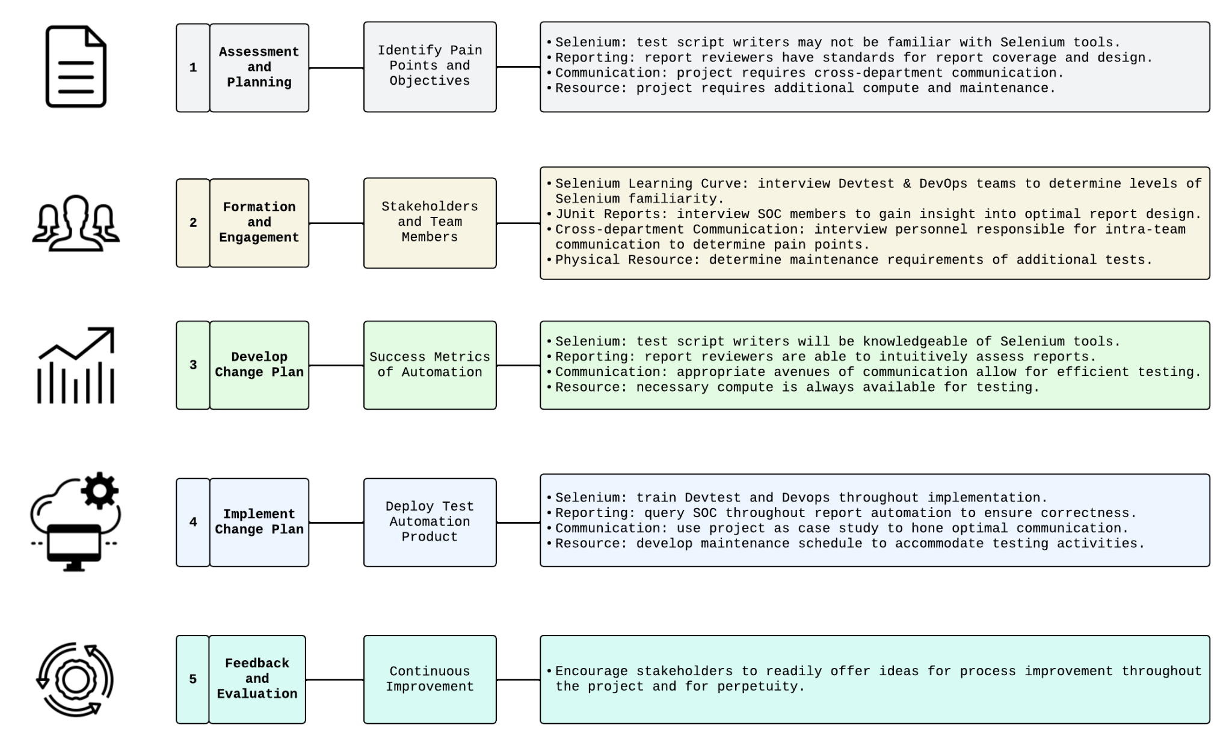
Change Management [1]
[1] 2024. 5 critical steps in the change management process. Retrieved May 17, 2024 from https://www.atlassian.com/blog/strategy/change-management-steps
Backup

Slide 24
Release Criteria
Increment | Theme | Criteria | Verification Method (critical V&V steps)
Increment 1 | Precision | 20% reduction in false positives when compared to manual testing. | Compare the number of false positives from automated tests to historical data from manual tests. Calculate the percentage reduction and confirm it meets the 20% target.
 |  | 100% pass rate for the results of automated tests when compared with historical manual test results (test strategy theme: precision) | Generate detailed reports from both automated and historical manual tests. Perform a side-by-side comparison of test results, focusing on critical test cases. Log discrepancies as bugs in Bugzilla for further analysis. Resolve all discrepancies to ensure 100% resolution rate.
 |  | 100% pass rate for integration tests of integrate Selenium with Jenkins CI/CD for the 120 manual tests (test strategy theme: efficiency) | Verify Jenkins pipeline configuration to ensure Selenium scripts for the 120 manual tests are integrated. Run a set of test scripts through the CI/CD pipeline and success rate of execution will be recorded in Detailed test result reports using TestRail. Track and resolve 100% any integration issues in Bugzilla.
 | Efficiency | Achieve a 50% reduction in execution time for Selenium Grid tests across multiple browsers compared to initial setup. | Configure Selenium Grid for parallel testing and execute tests. Monitor and document the initial and optimized execution times and resource usage. Calculate the percentage reduction in execution time and confirm it meets the 50% target.
 |  | Reduce the setup and automated test execution time for 120 automated unit tests and 30 manual unit tests to a total of 72 hours. | Track and record the total setup and execution time for all 150 tests. Ensure the combined time for setup and execution does not exceed 72 hours. Compare the setup and execution times to previous benchmarks and log delays and issues in Bugzilla. Calculate and verify the setup time reduction to meet the 72-hour target.
Backup

Slide 25
Release Checklist
（Focus: Increment 1）
Test Strategy Theme | Criteria | Artifact | Responsible | Accountable | Consulted | Informed
Precision | 20% reduction in false positives when compared to manual testing | Comparison report with history data | Brian Tran (IT DevTester) | Jamie Teller (DevOps Engineer) | Krista Adams (Product Engineer) | Alex Hart (Security Manager)
 | 100% pass rate for the results of automated tests when compared with historical manual test results | Detailed reports from automated and historical tests | Brian Tran (IT DevTester) | Jamie Teller (DevOps Engineer) | Krista Adams (Product Engineer), Security Manager | Jennifer Clark (SOC Analyst)
 |  | Side-by-side comparison document | Brian Tran (IT DevTester) | Jamie Teller (DevOps Engineer) | Krista Adams (Product Engineer), Security Manager | Jennifer Clark (SOC Analyst)
 | 100% pass rate for integration tests of Selenium scripts with Jenkins CI/CD for the 120 manual tests | Detailed test result reports using TestRail | Brian Tran (IT DevTester) | Jamie Teller (DevOps Engineer) | Krista Adams (Product Engineer), Security Manager | Jennifer Clark (SOC Analyst)
Efficiency | Achieve a 50% reduction in execution time for Selenium Grid tests across multiple browsers compared to initial setup | Initial execution time report | Jamie Teller (DevOps Engineer) | Jamie Teller (DevOps Engineer) | Brian Tran (IT DevTester) | Krista Adams (Product Engineer)
 |  | Optimized execution time report | Jamie Teller (DevOps Engineer) | Jamie Teller (DevOps Engineer) | Brian Tran (IT DevTester) | Krista Adams (Product Engineer)
 | Reduce the setup and automated test execution time for 120 automated unit tests and 30 manual unit tests to a total of 72 hours. | Execution time summary | Brian Tran (IT DevTester) | Jamie Teller (DevOps Engineer) | Krista Adams (Product Engineer) | Alex Hart (Security Manager)
Backup

Slide 26
Version Policy
VERSION Key Factors:[1,2]
Traceable with BUILD. BUILD is coupled with product development or test engineering build farm (files, directories; packages, modules, functions/procedures; components, containers; subsystems).
CyberSIEM build farm is structured into THREE directories: PRECISION, EFFICIENCY, SECURITY, .
Build Types: D for development build (unit tests); A for Alpha build; B for Beta build; S for System test build; R for regression test build; I for Integration Build; P for Performance test build; G for Production GOLDEN build.
VERSION Rules[3]:
MAJOR.MINOR.DOTDOT.[P<PRECISION>,E<EFFICIENCY>,S<SECURITY>].[BUILD TYPE].[DEBUG BUILD OR NOT : D for debug, ND for non-debug].number [1-N]
MAJOR starts from zero at the beginning of the project and ends with 1 when it’s ready to be fully integrated.
During the intermediate sub-milestones, MINOR will have different numbers rounding up to 10 for different modules.
Patch number changes when a new feature is added or modified. This is normally for small bug-fixes or the like.
[1] SemVer. 2020. Semantic Versioning 2.0.0. Retrieved June 3, 2024, from https://semver.org/
[2] Microsoft. 2024. Versioning. Retrieved June 3, 2024, from https://learn.microsoft.com/en-us/dotnet/standard/assembly/versioning
[3] Stack Overflow. 2024. What rules does software version numbering follow?. Retrieved June 3, 2024, from https://stackoverflow.com/questions/3826580/what-rules-does-software-version-numbering-follow
Backup

Slide 27
“Translate Initial 60 Test Cases” RACI ^{[1]}
[1] TeamGantt. RACI Chart Definition, Tips, and Example. Retrieved June 2, 2024, from https://www.teamgantt.com/blog/raci-chart-definition-tips-and-example#:~
=simple%20RACI%20chart-,RACI%20definitions%20explained,have%20on%20an%20individual%20deliverable
Theme | Tasks | Responsible | Accountable | Consulted | Informed
Review and Select 60 Critical Test Cases | Identify critical test cases from the manual test suite | SOC Analyst: selects critical tests from customer perspective | Security Manager: verifies that test cases capture critical controls | DevTest: advises selection from IT maintenance perspective | Product Engineer
 | Prioritize test cases based on criticality and impact | SOC Analyst | DevTest: verifies that tests are automatible | Product Engineer: ensures initial test selection is representative of UI BATs | Security Manager
 | Document selected test cases | SOC Analyst | Security Manager | DevTest | CIO
 |  | Product Engineer
Translate Test Cases into Java Using Selenium Webdriver | Create Java Classes for test cases | DevTest | Product Engineer: ensures code quality | DevOps: opportunities for CI/CD efficiencies | Security Manager
 | Write Selenium scripts for each test case | DevTest | Product Engineer | DevOps | Security Manager
 | Ensure scripts are modular and reusable | DevTest | Product Engineer | DevOps | Security Manager
Internal Review and Verification | Peer review of translated test scripts | Product Engineer | DevTest | SOC Analyst | Security Manager
 | Execute test scripts to verify functionality | DevTest | SOC Analyst: expected test points covered | Product Engineer: opportunities to reuse BAT sample data | Security Manager
 | Make necessary adjustments based on feedback | DevTest | SOC Analyst | Product Engineer | Security Manager
Backup

Slide 28
Draft Report Sprint Backlog Execution
Sprint 1 (18 points)
Sprint 2 (39 points)
Sprint 3 (62 points)
April 12: (Proposal) Context Setting & Articulation (12 pts)
Context/Setting (3 pts)
OSS Project (5 pts)
Hypothesis (2 pts)
Challenges (2 pts)
April 9: OSS Research (6 pts)
Upstream (3 pts)
Downstream (3 pts)
April 19: OSS Principles (5 pts)
Whos, Who (5 pts)
April 19: Market Research (11 pts)
SWOT (3 pts)
COMP Analysis (5 pts)
GOAL/Problem (3 pts)
April 19: ROI/ROV (13 pts)
ROI (8 pts)
ROV (5 pts)
April 19: SW Disaster (5 pts)
Relevance (2 pts)
Risks (3 pts)
April 19: [Replan] Context Setting & Articulation (+ 5pts)
April 25: SDLC Model (8 pts)
April 25: 5 Personas (2 pts x 5 = 10 pts)
Characterization (1 pts)
Rationalization (1 pts)
April 25: 5 User Stories (5pts x 5 = 25 pts)
Epic Stories (2 pts)
Decomposition (3 pts)
April 25: Relative Sizing Algo (5 pts)
April 25: Roadmap (8 pts)
April 26: Burnup Chart (3 pts)
April 27: Sprint 1 Planning (3 pts)
Backup

Slide 29
Final Report Sprint Backlog Execution
Sprint 4 (14 points)
Sprint 5 (47 points)
Sprint 6 (34 points)
May 20: Architecture, design (8 pts)
Architecture: Call and Return (8 pts)
May 20: As-Is, To-be (10 pts)
As-is (5 pts)
To-be (5 pts)
May 20: User Story Update (6 pts)
DevOps (2 pts)
Dev/Test (2 pts)
Prod Engineer (2 pts)
May 20: SMART Update (3 pts)
May 21: Change Management (3 pts)
May 21: Risk Management (3 pts)
May 23: Testing (8 pts)
Testing Methodology/Rationale (5 pts)
Test Matrix (3 pts)
May 23: Product Roadmap Update (3 pts)
May 23: Burnup Chart Update (3 pts)
May 14: As-Is, To-Be (2 pts)
Adding personas & relevant details as needed (2 pts)
May 14: ROI/ROV (3 pts)
Productivity as ROI (3 pts)
May 14: User Story update (4 pts)
SOC Analyst (2 pts)
SOC Manager (2 pts)
May 14: Story Point Algo Update (3 pts)
May 14: Challenges Update (2 pts)
May 28: Architecture, design (5 pts)
High level design (5 pts)
May 28: Release (11 pts)
Bug Lifecycle (3 pts)
Bug Management Criteria (2 pts)
Release Criteria (3 pts)
Release Checklist (3 pts)
May 28: Release Plan (8 pts)
May 28: Project Plan (5 pts)
May 28: OSS execution (5 pts)
Backup

Slide 30
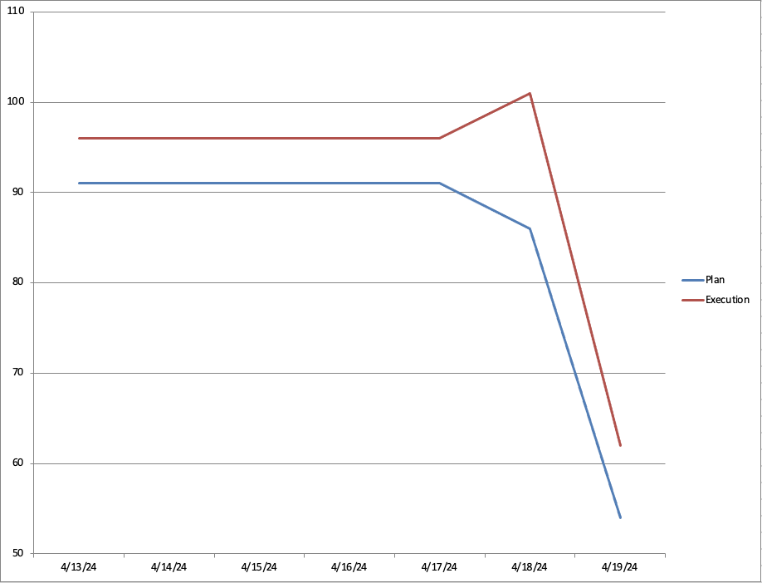
Sprint 2 Burndown Chart
Replan
Backup

